Slide 1
Bio Innovation of a Circular Economy for Plastics
Dr. Margaret Brennan Fournet

Slide 2
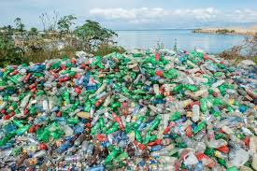
A €7 M Horizon 2020 EU-China Flagship project
A Sustainable route to mitigate against plastic pollution

Slide 3
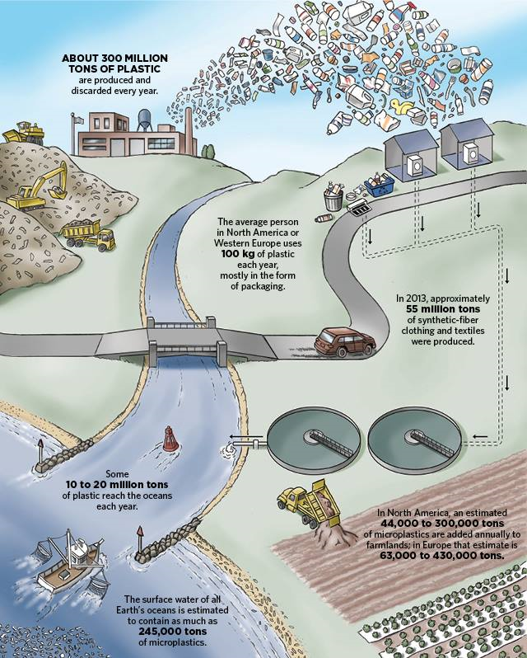
Technology to Biotransform Waste Stockpiles
I5 Partners, 9 Countries
Our Plastic Dependent Lives
Pollution Blackspots

Slide 4
Plastic Waste New Boplastics
Instrumental in global mission to sustainably transition from petroleum based plastics
Bioprocessing
New Bioplastics & Bioproducts
Biodegradation
Completing Plastics Life-Circle :
Our team will operate innovative technologies to accelerate plastic biodegradation that would organically develop over much longer time scales.

Slide 5
IMPACT: High Value Sustainable products
e.g. Bioplastic Food packaging, 3D bioprinting , Biopharmaceuticals
Contributing to TWELVE of seventeen UN Sustainable Development Goals
Job Creation
Company savings
New knowledge development
New market opportunities
Innovative product development
Technology transfer
research to industry
Enhanced international co-operation
cross-continent collaboration

Slide 6
Thank you
Contact: Dr. Margaret Fournet mfournet@ait.ie

Slide 7
All Green Performance vs Best Established and Emerging Bioplastics
 | Biodegradable biocompatible | Not competing with food supply | Lower carbon footprint production | Low energy production | High performing products
BioICEP | High | High | High | High | High
Emerging Approaches | High | Medium | Medium | Medium | Medium
Established Industry | High | Low | Low | Low | High

